Slide 1
Presentation of Work
Thiago Santos da Silva
Student Number: 2020327

Slide 2
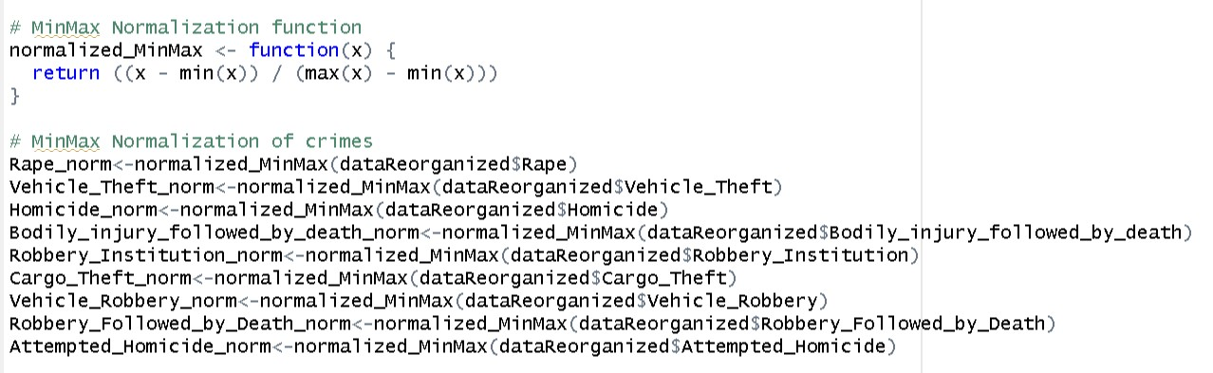
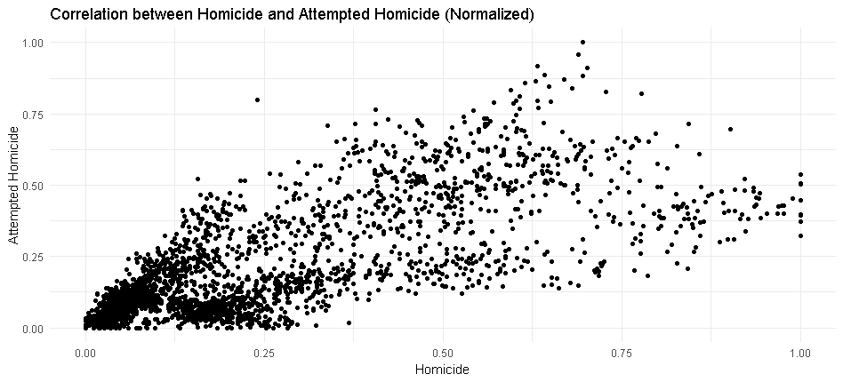
Min-Max Normalization
Code for Min-Max Normalization
Plot (Correlation between Homicide x Attempted Homicide

Slide 3
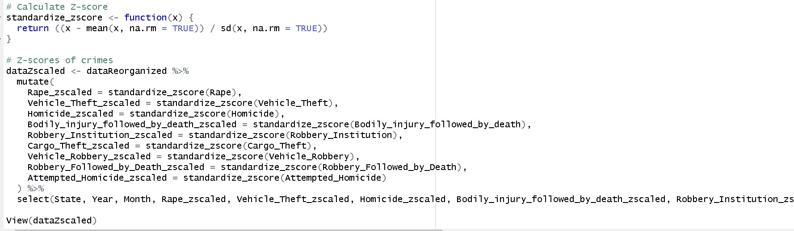
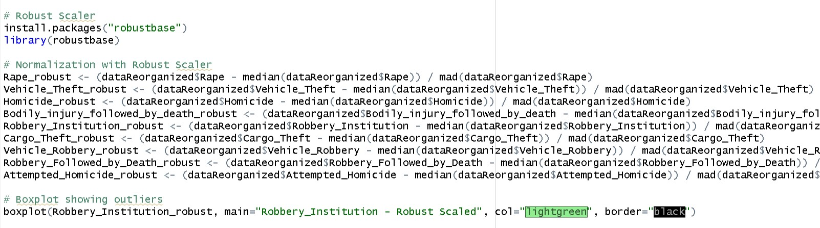
Z-Score and Robust Scaler
Code for Z-Score Standardization
Code for Robust Scaler

Slide 4
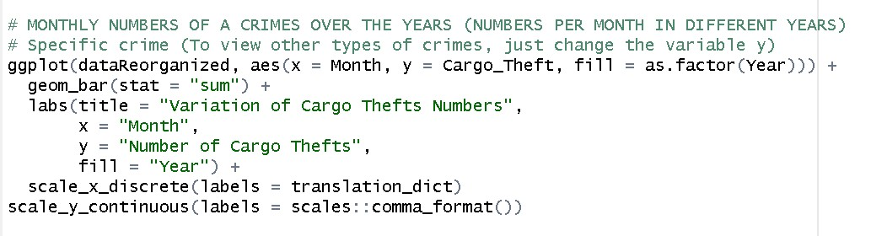
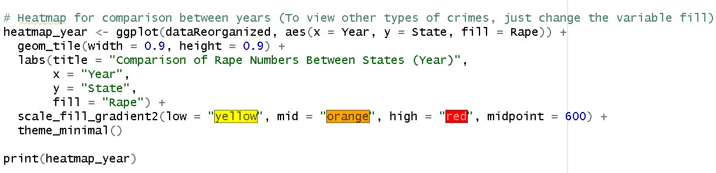
Bar Plots and Robust Scaler
Code for Bar Plots
Code for HeatMaps

Slide 5
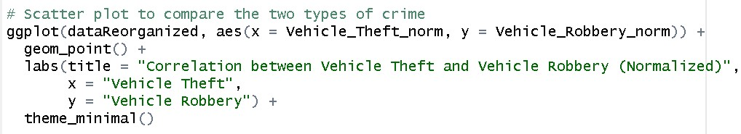
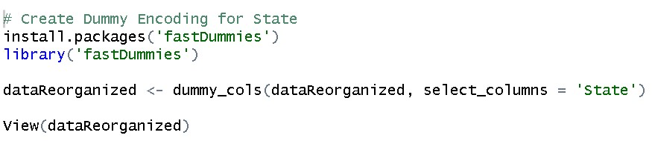
Scatter Plots and Dummy Encoding
Code for Scatter Plots
Code Dummy Encoding

